Slide 1
Contents
0. Kick-of sessions
  - Applying through real cases what was learnt in 4 trimesters
  - Identifying which additional tools we need to tackle them
I. Individual behavior (opening the “black box” on individuals)
  1. Role of rationality
  2. Incentive management
II. Organization (the “inside” of firms)
  3. Markets & organizations. Divisionalization
  4. Markets & politics
III. Institutions (the “outside” of firms)
  5. Institutional support of private contracting
  6. The role of firms in society, CSR

Slide 2
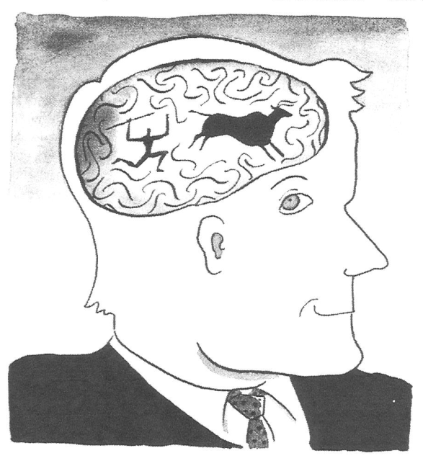
I. Individual behavior
1. The role of rationality
Based on Arruñada, Benito (2008), “Human Nature and Institutions,” in E. Brousseau and J.-M. Glachant, eds., New Institutional Economics: A Guidebook, Cambridge University Press, Cambridge, 81-99.

Slide 3
Bridging the gap:
Why individual behavior?

Slide 4
We’re familiar with key dimensions in human conduct
Economics
  Self-interest
  Rationality
With variety across individuals, situations, etc.
  Self-interested <-----------------------------> Altruist
  Rational <-------------------------------------> Emotional
With daily deviations from both
  Altruistic cooperation: love, tips by foreign tourists, etc.
  Failures of rationality: lack of self-control, revenge, etc.
    Cognitive “biases”—e.g., asymmetric value function (next slide)

Slide 5
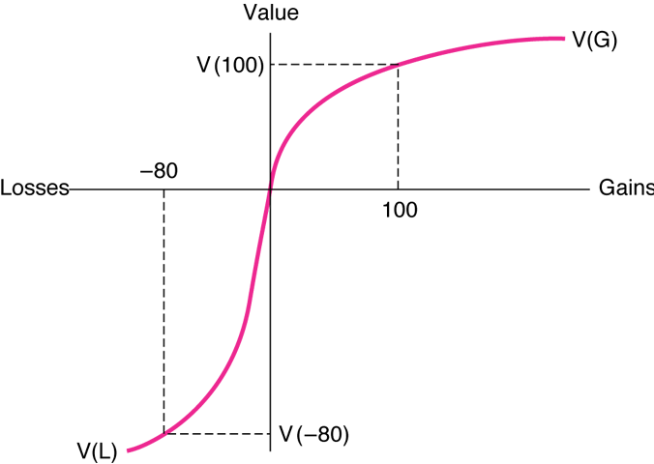
Bus. Econ: Prospect Theory (Asymmetric value function)
- defined on changes of wealth
- aversion to losses → steeper for losses
- decreasing marg. utility →concave in gains, convex in losses

Slide 6
Ex. of bias: Decoy effect
(decoy = señuelo, engany)
A certain proportion prefers A to B
Price
A
C
B
Distance

Slide 7
Adding a decoy
Adding a “dominated” option C (“irrelevant”?), does it affect the proportion of people inclined to prefer A to B?
Price
A
C
B
Distance

Slide 8
Irrelevant options (“decoy effect”)
When adding “dominated” option C (“irrelevant”), the proportion of people inclined to the nearby option (B) increases
Price
A
C
B
Distance
Which dating tips can be derived from this? ☺
Food for thought: although C is dominated,
  Is it truly irrelevant?
  Could not it be informing that the next option is relatively better? (in similar, real, situations)

Slide 9
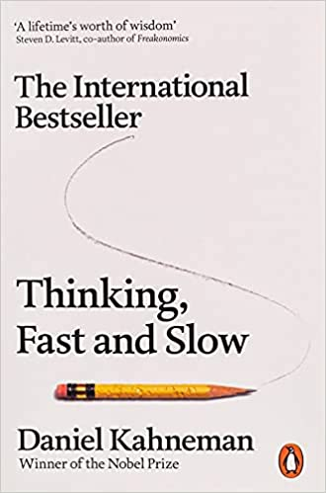
The two systems in our brain

Slide 10

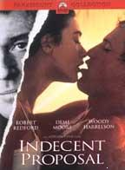
Emotional commitment and Adam Smith on love to children & parents

Slide 11
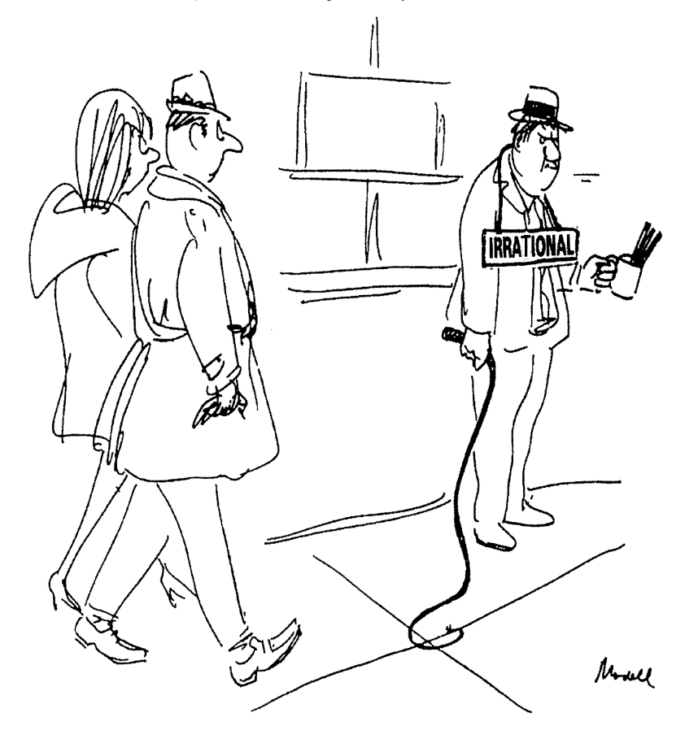
Ex. emotional commitment to retaliate

Slide 12
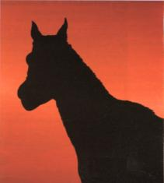
Are not these biases mistakes only in a specific context?

Slide 13
For discussion
How is the context evolving? More or less…
  Artificial?
  Manipulated? Advertising?
Cognitive biases re the pandemic?
  value function in political decisions
  discounting

Slide 14
For discussion
If you work for a candidate for the president of Barça, what would you advise regarding debates? With how many? With whom?
Think about
  what are the relevant dimensions?
  place the candidates
  try to be surrounded by whom?

Slide 15
How to react to biases & limitations?
Three conflicting positions in cognitive sciences
See Stanovich, “The Need of Rationality in a Hostile World”
Meliorists:
  should domesticate System 1 reactions (emotional) bc maladapted: not conducive to instrumental rationality, to achieve our goals
Panglossians:
  We do well enough
  Really? Life is becoming like the tests in the biases and heuristics literature
Apologists: intermediate, pragmatic, position

Slide 16
Four typical errors
Weak reasoning ability, system 2
Strong system 1, emotions
Lack of knowledge
Wrong knowledge →
  confirmation (myside) bias
    Worst risk of the four, bc uncorrelated with intelligence

Slide 17
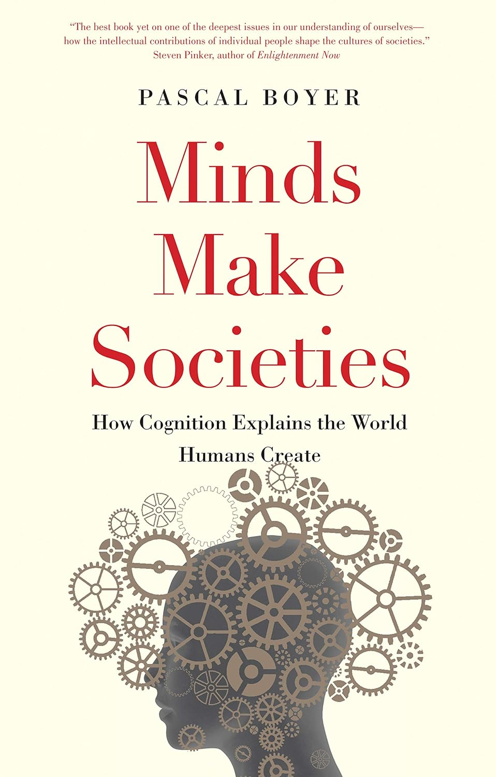
Intriguing: “social sciences suffer cognition blindness” (Boyer’18)
But how were and are minds made?
Myths of nature and nurture

Slide 18
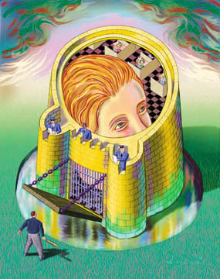
The mind had been off limits for evolutionary analysis

Slide 19
Overview
Evolutionary psychology—A Copernican revolution
  Reverse engineering of our mind
  Consequences for: rationality, cooperation and culture—i.e., for managing the inside and the outside of organizations
  Watch this brief overview video clip
Applications
  ‘Farsighted contracting’ in TCE
  Understanding management & policymaking

Slide 20
Outline:
Our mind & our institutions
Cognitive specialists | Rationality (decisional mechanism) | Cooperation (main ambit of interest) | Culture & institutions
Modular mind | Instinctive |  | Co-opt instincts
Maladapted mind | Ecological |  | Fill adap-tation gap

Slide 21
Source of humans’ comparative advantage: cognition
=
We are cognitive specialists
→
Constrained flexibility
& success

Slide 22
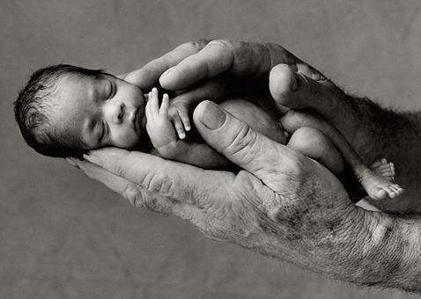
A major constraint of being cognitive specialists: all born... “prematurely”
Physiological:
  big brains
  big hips
  born helpless,
  learning; and
But also institutional:
  Family &
  responsible
  fatherhood, with
  Long education
  (do you take the hint?)

Slide 23
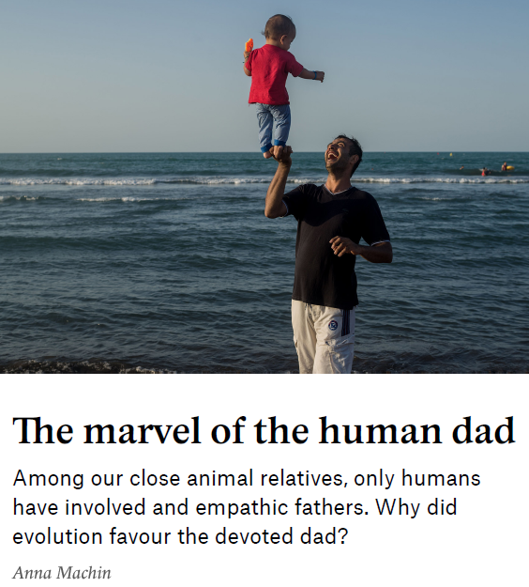
Link to article

Slide 24
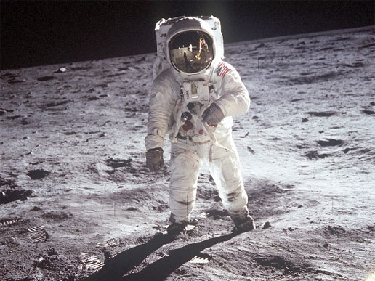

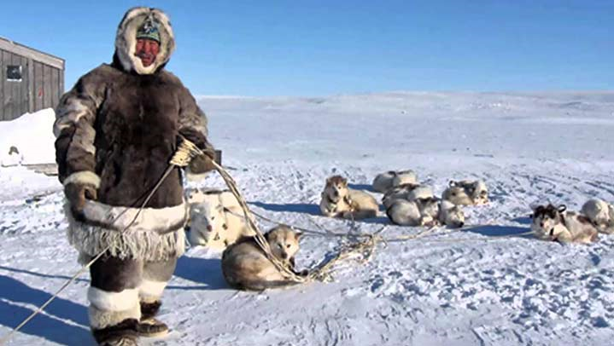
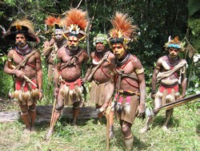
Amazing flexibility & success

Slide 25
We succeeded in being cognitive specialists: modularity & adapt. → map
Modular mind (≈ “apps” in smartphone)
  More efficient in using information with different structures in each environment
  Content-full of innate solutions (instincts, in brief)
    grammar acquisition, sex attraction, fear, social exchange, etc.
Adapted mind → risk of biological maladaption:
  Cognition → technological change faster than biological evolution → success + maladaptation
    Success because animals only adapt biologically
    Maladaptation b/c we change environment faster than instincts
    Huge role for cultural adaptation

Slide 26
Mind & institutions (I):
Consequences of cognitive specialization
Cognitive specialists | Rationality | Cooperation | Culture & institutions
Modular mind | Instinctive |  | Co-opt instincts
Maladapted mind | Ecological |  | Fill adap- tation gap

Slide 27
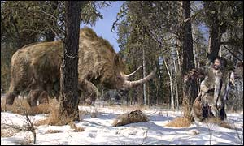
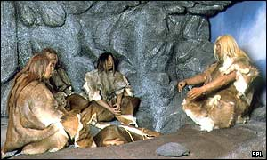
Maladaptation hypotheses: Our mind evolved to cope with this environments
“Environment of Evolutionary Adaptation:”
hunter-gatherers near subsistence level during the Pleistocene (1,800,000 to 10,000 years ago)

Slide 28
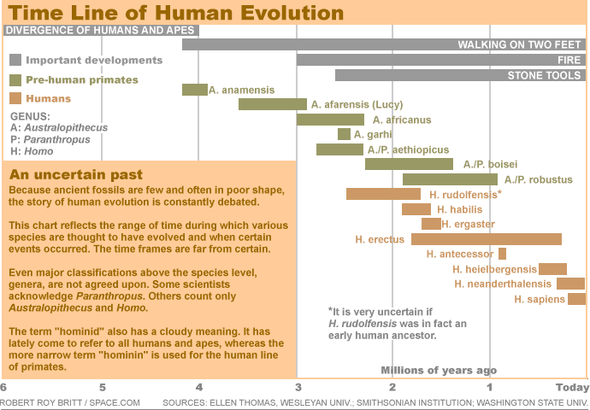
2,025 years

Slide 29
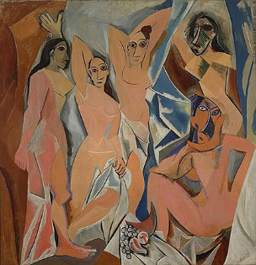
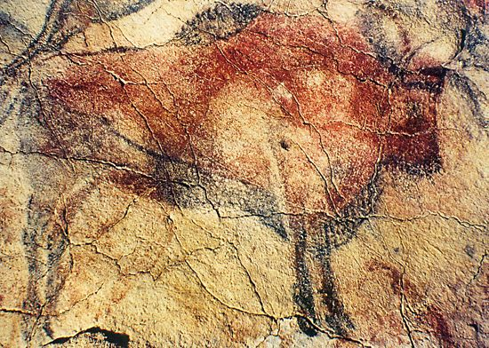
Cognition → Maladaptation.
Both paintings have the same age:
(one minute)

Slide 30
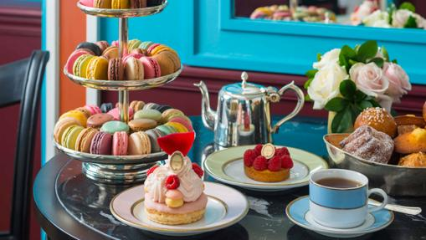
Example: Food preferences module
“Sweet tooth” & fat

Slide 31
Example: food preferences module
Why do we like sugar and fat?
Was such preference optimal? Is it now?
How do we deal with it?
  Look for examples of culture, institutions, education, self-control, rationality, emotions
Does it determine our weight?
Implications: What can we do…
  … in our daily life
  … as managers? At Danone? McDonald’s? Searle Inc.?
    Is lowfat food sweeter? Why?
  … as economists? At the Ministry of… Health? … Education?

Slide 32
Generalizing “sweet tooth”
Instincts are present
Poorly adapted b/c environment changes
Cultural complements regain adaptation
  Often relying on other instincts
Influence does not mean determinism
Business applications: “Greek” to “Vitalinea”
Similar questions about, e.g.,
  fear?, love?, xenophobia?, happiness?

Slide 33
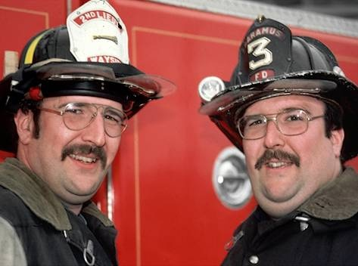
Genetic determinism?

Slide 34
Mind & institutions (II): Rationality
Cognitive specialists | Rationality | Cooperation | Culture & institutions
Modular mind | Instinctive |  | Co-opt instincts
Maladapted mind | Ecological |  | Fill adap- tation gap

Slide 35
Instinctive rationality
Obvious
  Hunger → search of food → feeding
  Disgust → poisoning avoidance
  Fear → mobilization of resources
  Sex drive → reproduction
    In the interest of whom? E.g., The Selfish gene?
Harder to make sense of
  Happiness → effort? Why does it not last?
  Consciousness of oneself?
  Etc.

Slide 36
Rationality
Instinctive means “Better than rational”:
  Our mind solves ‘ill-posed’ problems
  Using automatic instincts, heuristics, emotions
Economically → ecological rationality
  Solves well survival-relevant problems (e.g., food gathering, status, reproduction)
  Does not care for trivial problems (e.g., science)

Slide 37
Instinctive problem-solving is better than rational
Impossible problems: e.g., vision = 2D → 3D
  Ex: Is the horse coming or going?
  Presence of several heuristics noticeable when only one is present → poor perception
In general:
  biases & anomalies, but in which environments?

Slide 38
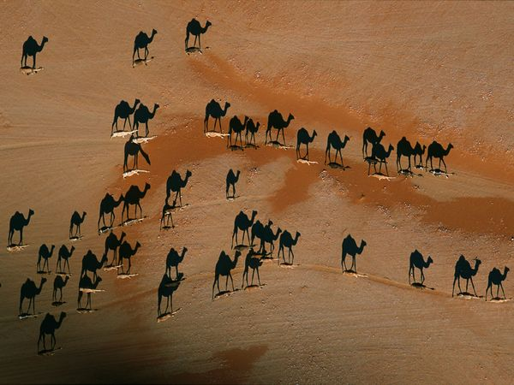

Slide 39
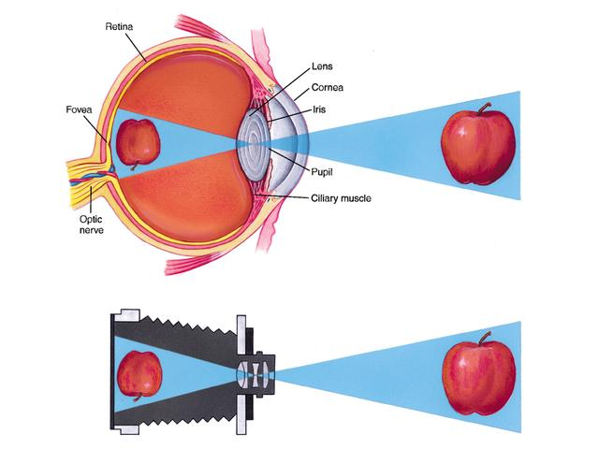
Instinctive rationality is better than rational
Vision is much more than a camera

Slide 40
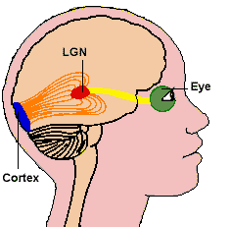
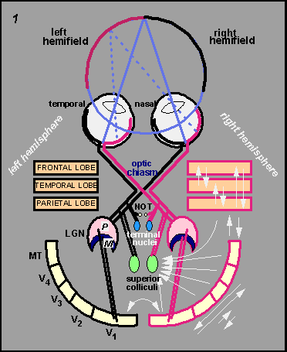
Vision is mainly a software suite

Slide 41
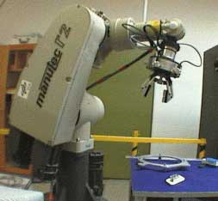
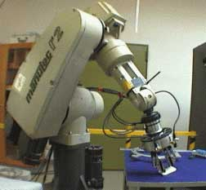
Ex. “Real-time visual servoing for object grasping”
§
Visit the Institute of Robotics and Mechanotronics and the “First humanoid that will open doors“

Slide 42
Ex.: mechanical harvesting:
Why software does not read this but we humans do?

Slide 43
Simple covid question
Assuming
    Incidence = 600/100,000
    PCR 99% accurate
  What is the probability of being sick if your PCR is “positive”?
Assuming random sampling of a person in the whole population,
  P(sick/positive) = 0.3764
  But, assuming a riskier group (doctor, non-vaccinated), e.g., with 6,000/100,000 incidence,… 86%
Notes:
99400→994 + 98406
600 →6 + 594
994 + 594 = 1588
594 / 1588 = 37.64%

Slide 44
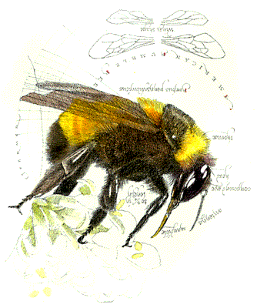
Ecological rationality: sophisticated solutions… but only for context-relevant problems
Ex., if bees are good Bayesian calculators, should not humans be also good?
  We are, instinctively: “Bayes Rules”
  (The Economist, 7-1-2006: 70-71).

Slide 45


Slide 46
Mind & institutions (III): Cooperation
Cognitive specialists | Rationality | Cooperation | Culture & institutions
Modular mind | Instinctive |  | Co-opt instincts
Maladapted mind | Ecological |  | Fill adap- tation gap

Slide 47
Cooperation
Instinctive
  Genetic relatedness → nepotism
  Reciprocity:
    Based on continuity of exchange requires:
      Identification of individuals and conducts → Cheating detectors
      Account → memory
    Based on different types of individuals
      Signaling and detection of cooperative types
      Emotional commitments:
        love, compassion, retaliatory drive,...
        moral taboos and “moral instinct”
  For groupishness (?): Conformity → Herd behavior
Ecological
  Relational frameworks

Slide 48
A map of a few cooperation instincts in different relational contexts
Transaction attributes: | Quality of human types
 | Fixed—can be committed to honesty | Variable—therefore, potentially opportunistic
- One-shot
- Repeated
Purpose: | Identification of types | Detection and punishment of cheaters

Slide 49
A map of a few cooperation instincts
Transaction attributes: | Quality of human types
 | Fixed—can be committed to honesty | Variable—therefore, potentially opportunistic
- One-shot | Facial expressions and their identifiers
- Repeated
Purpose: | Identification of types | Detection and punishment of cheaters

Slide 50
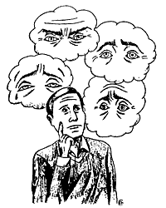
Instinctive cooperation (1):
Lack of facial control help us trading
Why is ‘acting’ so difficult?
Why do we still have business meetings?
Lie detectors?
Lovers: plenty of eye contact, pupils open, etc.

Slide 51
Instinctive cooperation (2):
Emotions produce commitment
Deterrence in irrational violence
Drive for status
Responsible fatherhood
Rationality
  Ex ante
  Ex post

Slide 52
A map of a few cooperation instincts
Transaction attributes: | Quality of human types
 | Fixed—can be committed to honesty | Variable—therefore, potentially opportunistic
- One-shot | Facial expressions and their identifiers
- Repeated
Purpose: | Identification of types | Detection and punishment of cheaters

Slide 53
A map of a few cooperation instincts
Transaction attributes: | Quality of human types
 | Fixed—can be committed to honesty | Variable—therefore, potentially opportunistic
- One-shot | Facial expressions and their identifiers
- Repeated | Genetic relatedness, Love, Compassion, Moral sense
Purpose: | Identification of types | Detection and punishment of cheaters

Slide 54
A map of a few cooperation instincts
Transaction attributes: | Quality of human types
 | Fixed—can be committed to honesty | Variable—therefore, potentially opportunistic
- One-shot | Facial expressions and their identifiers | Strong reciprocity leading to “irrational” retaliation
- Repeated | Genetic relatedness, Love, Compassion, Moral sense
Purpose: | Identification of types | Detection and punishment of cheaters

Slide 55
A map of a few cooperation instincts
Transaction attributes: | Quality of human types
 | Fixed—can be committed to honesty | Variable—therefore, potentially opportunistic
- One-shot | Facial expressions and their identifiers | Strong reciprocity leading to “irrational” retaliation
- Repeated | Genetic relatedness, Love, Compassion, Moral sense | Cheating detectors, Recordkeeping
Purpose: | Identification of types | Detection and punishment of cheaters

Slide 56
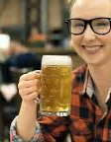
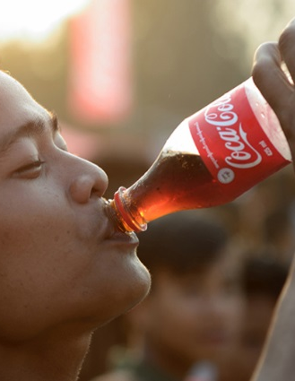
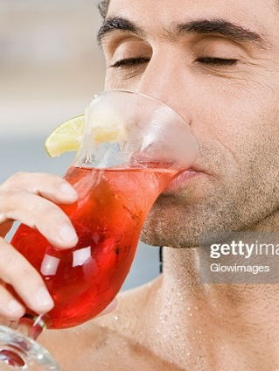
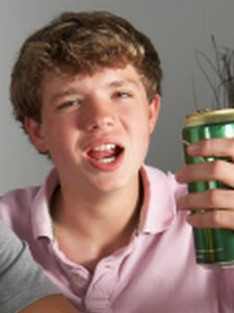
Instinctive cooperation (3):
Cheating detectors
Which of these do you check to enforce a drinking age rule (e.g., “you must be 21 to drink alcohol”)?
1, beer 2, Coke 3, old 4, teen

Slide 57
Instinctive cooperation (4):
Cheating detectors
Cards with letters and numbers, “enforce rule ‘D ⇒ 3’”
  D F 3 7
D F 3 7
We falsify abstract hypotheses badly but we do well when detecting cheaters, as in the drinking age rule
  Beer drinker Coke drinker 35 yr old 14 yr old
Beer drinker Coke drinker 35 yr old 14 yr old

Slide 58
Outcomes in a joint venture
 | Cooperator | Defector
Cooperator | 4 | 6
 | 4 | 0
Defector | 0 | 2
 | 6 | 2

Slide 59
In population with both types
Proportion of cooperators = h
Expected outcome for cooperators = 4h + 0 (1-h) = 4h
Expected outcome for defectors = 6 h + 2 (1-h) = 2 + 4h
 | Cooperator | Defector
Cooperator | 4 | 6
 | 4 | 0
Defector | 0 | 2
 | 6 | 2

Slide 60
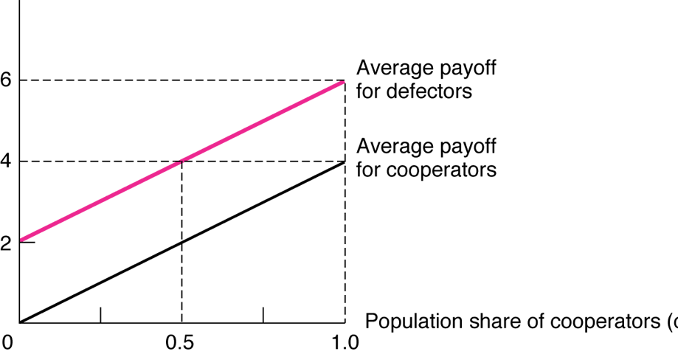
Average Payoffs when Cooperators and Defectors Look Alike

Slide 61
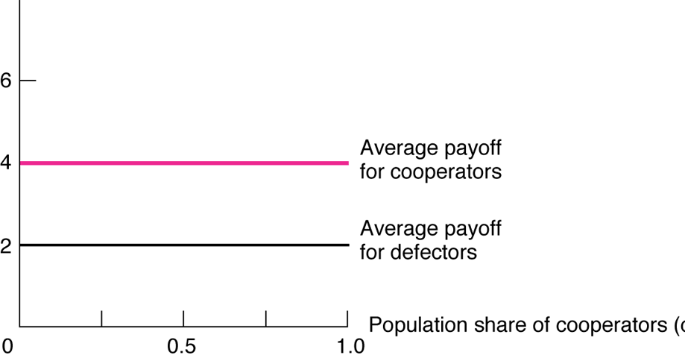
Average Payoffs when Cooperators Are Identifiable w/o Cost

Slide 62
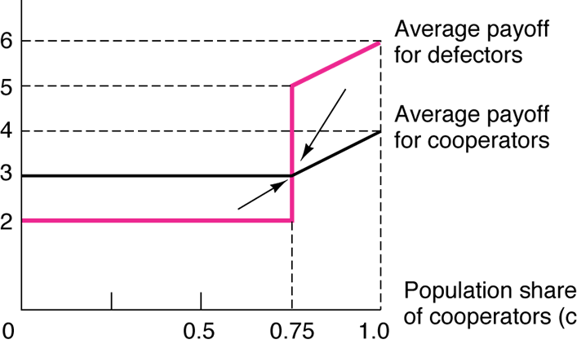
Average Payoffs when Defectors are Identifiable at Identification Cost = 1

Slide 63
Multiple human types may coexist → Commitment and identification strategies viable to achieve cooperation in human interaction

Slide 64
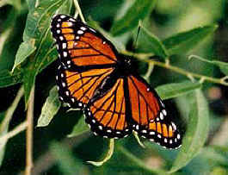
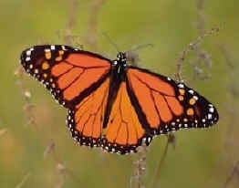
Mimicry
Viceroy
Monarch
http://www.kidzone.ws/animals/monarch_butterfly.htm

Slide 65
“The secret of success is sincerity. Once you can fake that, you've got it made”

Slide 66
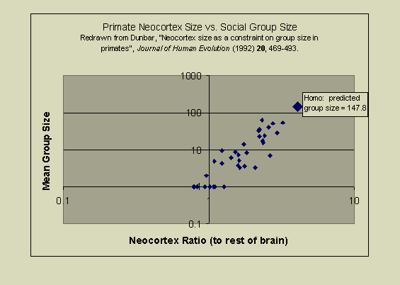
Primates’ Brain Size Positively Correlates with Group Size

Slide 67
Instinctive cooperation (#5): Strong reciprocity
Humans are willing to incur costs to punish cheaters even when there is no prospect of further interaction.
This propensity ends up achieving greater cooperation, however.
In “ultimatum” games, A divides 1000 € between himself and B, but none of them gets a cent if B rejects the offer. Usually, A divides by half and B rejects offers below 30%

Slide 68
In public good games, individuals contribute money to a common pool, expecting an equal share in a multiple of the pool
  People start contributing but their contributions decay with time and approach zero at the end
  When cooperators can punish free-riders even at a cost (“strong reciprocity”), they do it, motivating cooperation
  Depending on punishing circumstances, cheaters lead cooperators incapable to retaliate to cheat; or cooperators willing to incur costly retaliation lead cheaters to cooperate

Slide 69
Mind & institutions (III): Cooperation
Cognitive specialists | Rationality | Cooperation | Culture & institutions
Modular mind | Instinctive |  | Co-opt instincts
Maladapted mind | Ecological |  | Fill adap- tation gap

Slide 70
A map of a few cooperation instincts
Transaction attributes: | Quality of human types
 | Fixed—can be committed to honesty | Variable—therefore, potentially opportunistic
- One-shot | Facial expressions and their identifiers | Strong reciprocity leading to “irrational” retaliation
- Repeated | Genetic relatedness, Love, Compassion, Moral sense | Cheater detectors, Recordkeeping
Purpose: | Identification of types | Detection and punishment of cheaters

Slide 71
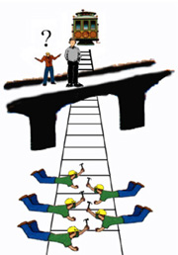
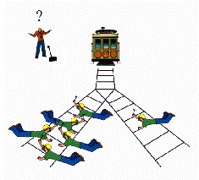
Instinctive cooperation (5):
Moral sense: The trolley case

Slide 72
+ on moral sense
Moral taboos—e.g., even discussing sale of human organs makes people unpopular.
  Does this explain something about economists?
  What about free market politics?
Simplest view: Moral “circle” →

Slide 73
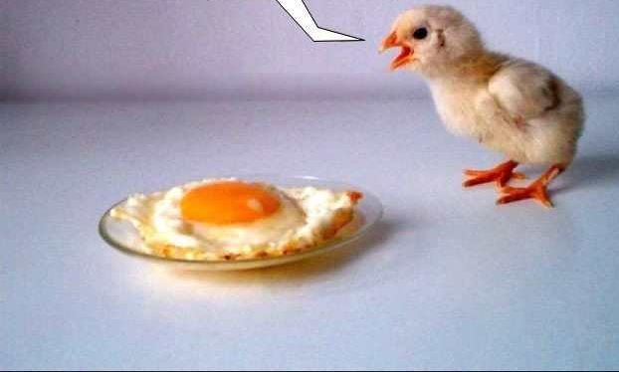
Moral circle

Slide 74
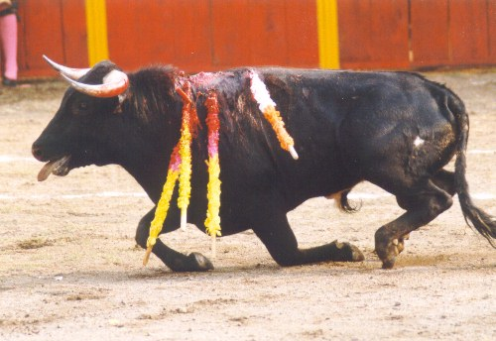
Nasty illustrations of moral circles

Slide 75
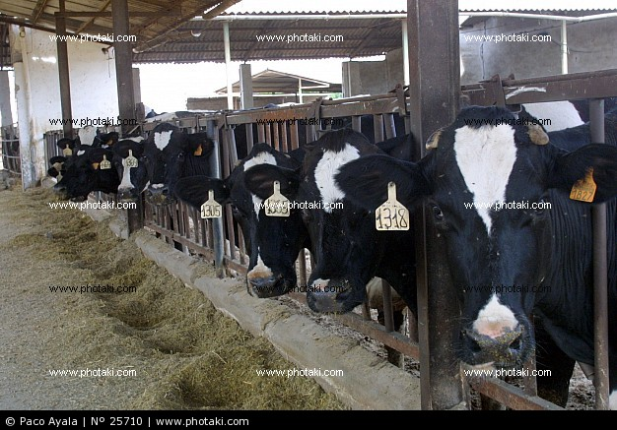
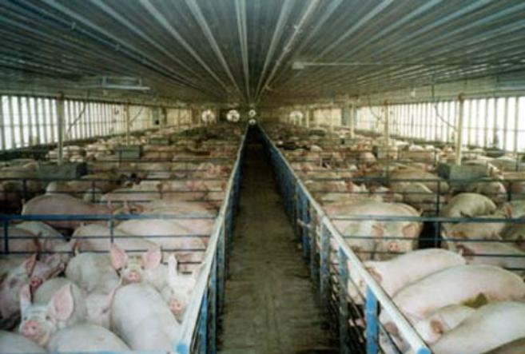
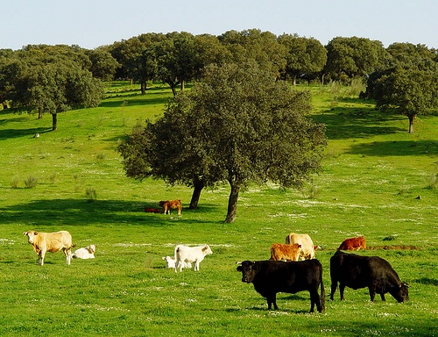
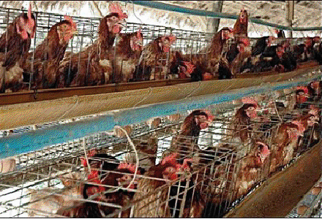
Is our moral circle “flexible”?

Slide 76
Moral sense
Identical instinctive mechanisms triggered
  Precluding certain actions (e.g., killing) or treatments (considering the costs and benefits of some actions)
  Reification of human beings → no guilt when treating them as things or insects (killing enemies in war action)
With moral circle boundaries culturally flexible
  Insects vs. pets, bulls in bullfighting or in meat production
  Human beings: strangers, enemies, race, etc.
    Trust → Mistrust
Examples
  Touching in trolley problem
  Corruption vs. ‘influence’: taking a bribe vs. queue jumping a friend waiting for surgery, cover up to the police
  Nazism, terrorism, war, etc.
  Forbidden markets: human organs, pollution rights

Slide 77
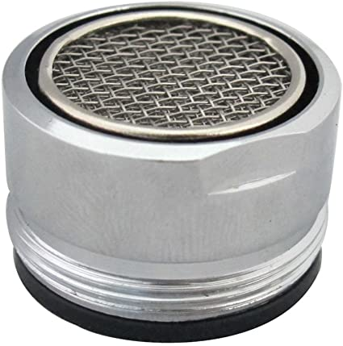
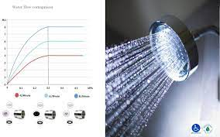
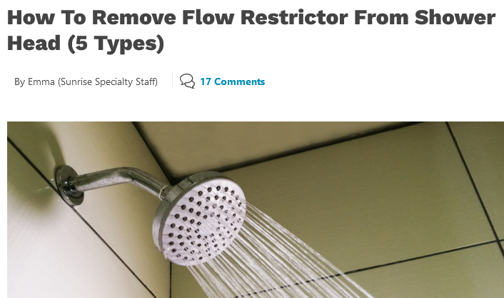

A “prices vs. morality” case: higher water prices or water flow restrictors?
Prices even if ecology is inside the moral circle?
Positive vs normative analysis →

Slide 78
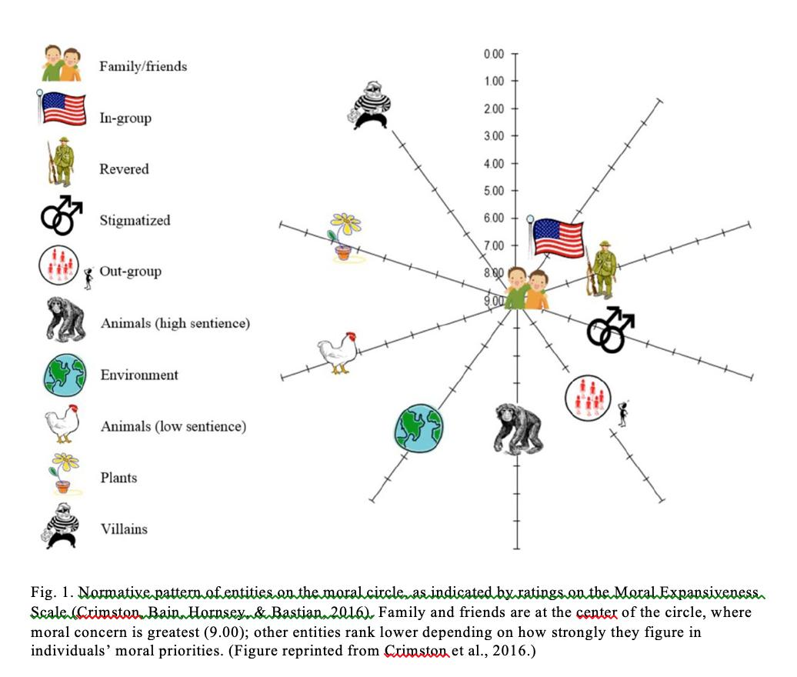

Slide 79


“Blondi”

Slide 80
Deontology or Trustworthiness?
​“The benefit that people get from taking a deontological position is that they look more trustworthy. Let's look at the other side of this. If I take a consequentialist position, it means that you can’t trust me because, under some circumstances, I might decide to break the rule in my interaction with you.” (Daniel Kahneman). (Video)

Slide 81

Moral “matrix”, w. common instincts but different preferences (J. Haidt)

Slide 82


Slide 83

Variety of moral types
Keep it in mind to enable fruitful conversation

Slide 84



Slide 85
A simple exercise to understand prejudice
Run one of these tests:
http://www.understandingprejudice.org/iat/index2.htm

Slide 86



Instinctive cooperation (6):
Conformity → herd behavior

Slide 87
Mind & institutions (III): Cooperation
Cognitive specialists | Rationality | Cooperation | Culture & institutions
Modular mind | Instinctive |  | Co-opt instincts
Maladapted mind | Ecological |  | Fill adap- tation gap

Slide 88
Ecological cooperation: Likely relational frameworks among hunter gatherers → Market relations are artificial, often counterintuitive?
Limited social interaction
  Small groups (<150 people) → hard to deal w. strangers
No technical change → zero-sum mentality
  Wealth accumulation caused by expropriation
Little capital
  Mobility limited use of capital goods to portable ones
Trade
  Based on reciprocity

Slide 89
Limited specialization (?)
  No government or military specialization
  Sex: hunting, warfare, gathering, children
    See, e.g., Stevens & Haidt on Google Memo
  Age: knowledge, grandmothers
Distribution (?)
  Sharing if predominant risk is exogenous
    Meat of big game
    Across-band insurance
  Private property if moral hazard is important: tools, fruits

Slide 90
Food for thought 1
Are we less
knowledgeable today?
  Colombian children surviving
  in the rainforest

Slide 91
Food for thought 2
Puzzle in anthropology and cognitive sciences:
  How were we able to create large ‘anonymous’ societies?
  In particular, are market relations ‘unnatural’?
    Specially if abstract (e.g., trade, interest, mediation, services)
    Specially if impersonal (strangers)

Slide 92
Mind & institutions (IV): Institutions
Cognitive specialists | Rationality | Cooperation | Culture & institutions
Modular mind | Instinctive |  | Co-opt instincts
Maladapted mind | Ecological |  | Fill adap- tation gap

Slide 93
The adaptive function of organizations & institutions
Fill the gap by controlling instincts poorly adapted to our new environment
  Rationality (self-control)
    Postponing gratification
  Cooperation (control)
    Violent anger → Third-party enforcement
  Cultures as technologies:
    E.g., genes & ethics of Romans, Christians & Modern Europeans, Puritans, oral confession
      Arruñada, Benito (2010), “Protestants and Catholics: Similar Work Ethic, Different Social Ethic,” The Economic Journal.
      Arruñada, Benito (2009), “Specialization and Rent-Seeking in Moral Enforcement: The Case of Confession,” Journal for the Scientific Study of Religion, 48(3), 443-61.

Slide 94


Slide 95
In short: How do we manage food preferences? E.g., the role of “disgust”
For the good
  Education → better adaptation
    Do not eat to much candy, fat. etc.
For the bad
  Food taboos → relations out of group are made harder → groups stronger
    School menus for immigrants?
In both, by co-opting disgust

Slide 96

Self-control’s main problem
Conjecture: Our innate subjective discount rate is too high (it’s adapted to less-stable environments) → Main function of education: to lower it
Application: Yourself? Which jobs? Deferred compensation?

Slide 97

Self-control’s goal: to postpone gratification

Slide 98

Co-opting, harnessing instincts as building blocks to achieve adaptation
A controversial ebate:
  Moralizing-, Big-God religions--i.e., mental parasite vs. prosocial harnessing of primitive instincts
  E.g., Christian theology
    Omniscient God
    Fear → punishing God → attrition
    Love → contrition
    Shame and guilt
    → confession
    Most sophisticated,
    and controversial:
    Oral confession

Slide 99

Social control: punishing free riders

Slide 100


Summing up:
A new view of the human mind
‘Blank slate’ mind
  Content-free
  Decides by general rules (probability laws, etc.)
  Cultural determinism
    Noble Savage
    Constructivism
‘Swiss Army knife’ mind
  Content-full
  Instincts essential for rationality
  Cultural interaction
    Preprogrammed learning
    Cultural universals

Slide 101


Evolution now reveals the weakness of two common myths
No noble savage
No ghost in the machine

Slide 102
Key concepts & caveats
Modular mind: in “rationality & cooperation
Maladaptation: ídem →
“Artificial” adaptation:
cultural, institutional, educational complements
No determinism
  nature vs. nurture—free will
  Cultural co-evolution
  be careful with how we use statistical means →
Notes:
102

Slide 103
Cultural evolution and group selection
Group instead of genic selection at the cultural level?
In any case,
  Essential to control free riding
    Groups are systems of indirect reciprocity, more than promoters of altruism—groups serve us
  Group selection no morally superior:
  Individual altruism leads to group selfishness: double moral standards in and out of group
    E.g., war unites nations: What about Spain since 1808?

Slide 104


Slide 105


Slide 106

Henrich (1)

Slide 107

Cultural co-evolution (Henrich 2)

Slide 108

Henrich (3)
Full presentation

Slide 109

Source: Stevens, Sean, and Jonathan Haidt, “The Google Memo: What Does the Research Say About Gender Differences?”, August 10, 2017.

Slide 110
Reasons for optimism
We are more in control than ever:
  our institutional technology uses and enhances our biology
We keep expanding our moral circle
  Band → nation → world, animals,…
  Should we be optimistic about it?
Institutions have performed nicer than genes:
  War deaths during 20th century were 100 times lower than in hunter-gatherers’ bands

Slide 111
Genetic determinism?
Nature and nurture are complements, no substitutes
  Discussion on relative weight is fallacious
  Nature needs nurture and vice versa
Explaining conduct does not justify it
  The possible existence of an instinct (now maladapted) to, e.g., violence does not excuse violence. On the contrary. Should it be punished more, not less, to get the same deterrence?

Slide 112
Freedom
Concepts of freedom
  To satisfy our instincts or to govern them?
  What should we do if we want to be free?
Does education make you free?
  Which education?
    Recording or thinking? Doctrinal?
    Academic or informal? Informal = self-control?
  What about “Tiger Moms”?
    Is there a lesson for us? Competition? Environment?
    Were we “Chinese” years ago?
Notes:
112

Slide 113

Institutions or instincts, sure. But... which of them are the “face” and which are the “mask”?
Opposite to the figure, instincts are “the face” and institutions are the adaptive “mask”
© Benito Arruñada. Barcelona, 2001. Tots els drets reservats.

Slide 114
Mind & management
Bonus track
Cognitive specialists | Rationality | Cooperation | Business
Modular mind | Instinctive |  | Co-opt instincts
Maladapted mind | Ecological |  | Fill adap- tation gap

Slide 115
Outline
Organization of exchange
  ‘Farsighted contracting’ in TCE
Management
  General management
  Managing people
  Finance
  Marketing

Slide 116
1. Organizing exchange
Assumptions in Transaction Cost Economics : bounded rationality & opportunism
Solution: “farsighted contracting”
  use of calculative rationality ex ante to develop safeguards against ex post opportunism
It often collides with instinctive “contractual heuristics”—mainly, with cheater detectors
  Example: Love and arranged marriages
Schizophrenic (and impossible?) palliative:
do not explicitly safeguard in daily life, in marriage contract, etc.

Slide 117
2. General management
Rationality
  The rationalizing function of firms
    See, e.g., slide in Beshear & Gino paper at HBR below
  Specialization
    Among humans: self-control
    Between humans and computers
Organizational structure
  “Natural” size of productive units: 100-200 individuals
  Informal org. struct.: gossip & “managing by wandering around”
Incentives (Topic #2)
  Delicate use because, e.g.,
    “Strong reciprocity” (Fehr)
    “Crowding out” (Frey)

Slide 118
Conjecture: loss aversion possibly “maladapted” today

Slide 119
Hypot. Net Present Value (€) of teaching methods
 | Traditional | Socratic
Initial investment | -12 | -20
Future annual return | 2,3 | 3
Discount rate

Slide 120
3. Managing people
“Biases”
  Loss aversion → resistance to change. Change only when facing disaster
  Over-optimism and overvaluation
  Self-deception–necessary for leadership? At what cost? More costly when combined with herding: remedies?
    Why do leaders usually feel alone? What do we ask them?
  Overvaluation of status
  Conformism →
    Herd behavior (of leaders)
    Role of rituals to consolidate groups: e.g., dancing
Detectors of human types and cheaters →
  Importance of personal contact → business travel
  Importance of cooperative climate for first interactions
Notes:
Map for Nicholson & The Econ’ Homo Administrans

Slide 121
4. Finance
Possible biases:
  overconfidence → too low premiums for risk
  herding → speculative bubbles (real estate), pyramidal frauds (e.g., Madoff, Foro Filatélico, preferentes, etc.)

Slide 122
5. Marketing
Brand management grounded on emotions & relationships
  What does Apple sell? Do customers like brands changing their logos?
Product design based on
  Visual & oral symbols, no abstractions (commands vs Mac-Windows)
  Pleasure without pain: e.g., artificial sweeteners
Sexist advertising, no only in contents but in approach
  Is advertising that addresses men sexist? … women? Examples?
Watch this brief video clip on “The Secret Science of Advertising”

