Slide 1
Firms & Society
Views on Corporate Social Responsibility (CSR)
B. Arruñada

Slide 2
Introduction

Slide 3
Initial questions (1)
What is “corporate social responsibility”, CSR?
Is CSR
Necessary for correcting market failures?
Democratic?
Does CSR affect corporate control?
What happens if an agent has several different objectives?
Does the “moral circle” apply to companies?
Whether small or large?
Whether they have a reputation or not?
Does it entail risks?

Slide 4
Initial questions (2)
Is there a conflict between social and individual responsibility?
What can/should we do if “Nike” trainers are the product of child labor?
Is there a conflict between morality and rationality?
Can morality be rational to different degrees?
Examples: Are the consequences of the following relevant?
Child labor
Aid in famine,. E.g. mosquito nets
How does the sale of “indulgences” work?

Slide 5
How are firms perceived? In particular, how are they portrayed in movies and TV?

Slide 6
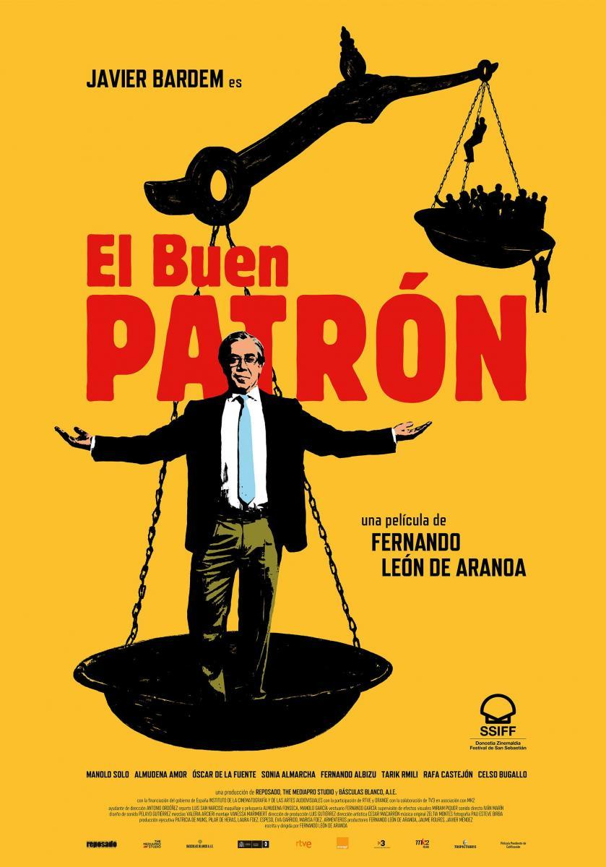

Slide 8
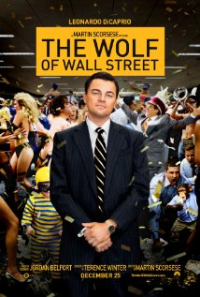
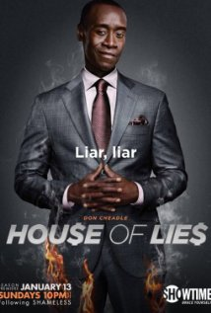
Watch the famous “Greed is good” clip

Slide 9
Firms in films & TV
How are different economic agents portrayed? (Objectives, morals, personal relations, etc.?)
Employees
Bankers
Scientists
Managers
Entrepreneurs
How are different firms portrayed?
big and small
rich and poor
strong and weak

Slide 10
CSR raises a mix of positive and normative questions
Normative
1) What should society demand from firms?
Profits but with legal compliance?
Ethical behavior?
If ethical behavior, who should define it?
2) In any case, how should managers react?
Positive
3) How are firms seen by society and stakeholders?

Slide 11
Outline
Introduction
Opposite normative views
US-Liberal view (Arrow, Freeman)
Free-Market view (Friedman, Fama)
Positive pillars to revise these views
Contractual view
Cognitive view

Slide 12
Outline
Introduction
Opposite normative views
US-Liberal view (Arrow, Freeman)
Free-Market view (Friedman, Fama)
Positive pillars to revise these views
Contractual view
Cognitive view

Slide 13
Normative, and opposite, views (a) The progressive (US “liberal”) view: ethical behavior—Arrow (b) The free-market view: legally maximize firm value

Slide 14
Arrow ’73 justifying CSR
Market-failure arguments
Monopoly
Externalities
Information asymmetries
Income redistribution
Crowding out of altruism
Better as an ethical code than as law:
more flexible (Arrow, also Fama!)

Slide 15
Do these justifications hold water? Arguably, not
Monopoly, externalities, income, etc.
These are policy questions: a free society should decide them relying on reason and with proper checks and balances
Crowding out of altruism
Evidence points out in the opposite direction:
greater cooperation observed in societies relying more on market exchange (Henrich et al., 2005—summary, 2001)
Are ethical codes superior?
More below, but think by now on usury prohibitions

Slide 16
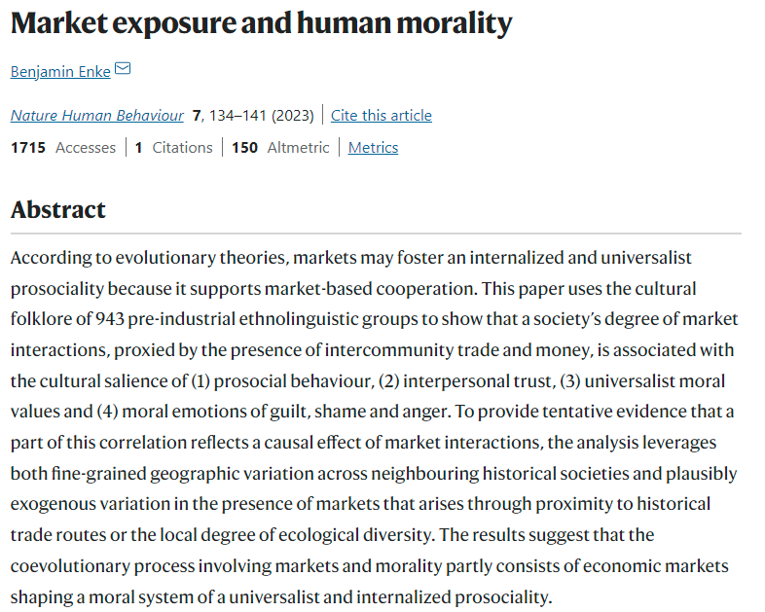
Markets do not crowd out altruism but encourage:
Prosocial behaviour
Interpersonal trust
Universalist moral values
Emotions of guilt, shame and anger

Slide 17
Current fashion: CSR → ESG
+ Concepts: sustainable, inclusive
Main authors / arguments
Hart & Zingales → welfare instead of wealth max.
Mayer: social preferences of legal persons → “purpose”
Piketty → labor reps. at corp. boards
Events:
institutional investors → ESG investment funds
Regulation → Directives on disclosure & due diligence
ESG audit & compliance industries → indulgences?

Slide 18
Normative, and opposite, views (a) The progressive (US “liberal”) view: ethical behavior (b) The free-market view: legally maximize firm value

Slide 19
Free-Market View
A. Smith: individual interest → collective good
→ See “A Map of CSR” next
Friedman: firms should aim for profits within the law
Which checks and balances to define the law?
Comparative advantage of politics over CSR?
The law of which country?
But think: Does it look good to (max.) profits?

Slide 20
On the CSR readings: good to ask yourself how do you think
What do Arrow and Friedman say in their articles?
Which of them do you agree with?
Which of them do you think is more “political”?
When we come up against arguments that go against our beliefs, do we tend to consider them more or less “political”, “ideological” or “immoral”?
How to move from beliefs to ideas?

Slide 21
To read & discuss
The NYT piece: Friedman, 1970
Two 2005 debates:
Business Week: Friedman contra R. Nardelli (CEO of Home Depot)
News on Mr Nardelli: accused of paying excessive salaries to himself, and ends up resigning.
Reason: Friedman against J. Mackey (CEO of Whole Foods)
Mackey’s blog
Discussion by Gary Becker
Hart & Zingales 2017
Are shareholders interested in welfare or in wealth (= value) at the individual securities or the portfolio level?
Are socially-responsible investment funds really good or do they fall into pernicious or even delusional CSR?

Slide 22
A map of CSR (Crook ‘05)
 | Raises social welfare | Reduces social welfare
Raises profits | Good management (www.salesforce.com) | Pernicious CSR (sustainable development, Nike in Malaysia)
Reduces profits | Borrowed virtue (corporate philanthropy) | Delusional CSR (recycling)
CSR “failures” of two types: 1) acting “irrationally”, so that it does not optimize (delusional); and 2) break bwn individual and social optimum (pernicious)

Slide 23
Outline
Introduction
Opposite normative views
US-Liberal view (Arrow, Freeman)
Free-Market view (Friedman, Hart & Zingales)
Positive pillars to revise these views
Contractual view
Cognitive view

Slide 24
Positive pillars to revise the classical views on CSR
(a) A contractual pillar

Slide 25
(a) Contractual pillar
Firm as nexus of contracts:
Fama ‘21: optimality of residual vs. fixed payoffs → contract structure
Lacks objectives, etc., like a market
But battleground for both internal and external private interests: e.g., modifying the moral code redistributes wealth
But seen from outside, a module for contracting, liable, etc.
Jensen ‘02: many objectives, no objective →
+ costly contracting →
more opportunism (e.g., managerial shirking, sale of indulgences)
Reputation as an enforcement device
Agency increases risk of business opportunism:
Short term incentives → reputation damage
Also controls compliance re moral code
But CSR as risk management (see Franklin’ 08)
To manage conflicts between stakeholder and within stakeholders?
Notes:
“Social” label as a disguise of private interests → e.g., see CSR as sale of indulgences, in next slides

Slide 26
(a+) Contractual pillar (Fama, Eugene F., 2021, “Contract Costs, Stakeholder Capitalism, and ESG,” European Financial Management, 27, 189-195. Criticisms in red)
Contract structures
Shareholders bear residual risk
Other agents → fixed payoffs with easier-to-control risks:
Contract writing and renegotiation PLUS law & courts
ESG: optimal Governance chosen
but there might be externalities (e.g., equal boards)?
ESG: Environmental & Social
Maximizing shareholders’ wealth is a result, not an assumption if they care about their portfolio, not about that of its components
Not if theirs is a moral criteria: unwilling to trade off across securities
Maximizing welfare instead of wealth
Operationalizing: firms do not know shareholders’ ESG exposures—moral criteria
Aggregating welfare’s multiple dimensions (Arrow’s impossibility theorem)
Contracting for them
Externalities better thru ESG activism?
‘Hayekian’ comparative advantage in specific vs. scientific information bwn moral-driven decentralized markets and politics-driven centrally-produced law

Slide 27
Our two pillars to revise the classical views on CSR
(b) A cognitive pillar

Slide 28
(b) Cognitive pillar, based on “contractual heuristics”
If trust matters when “contracting”, which consequences...:
... if we assert our goal is to maximize profits? … practice it?
... show ourselves as a compassionate firm, e.g., a “family”?
With respect to which communities? Workers, mass clients
Is it necessary to use different languages with different partners?
Some evidence: see Kahneman, Knetsch & Thaler (1986)
Presence of cognitive failure in mass consumer (& even financial?) markets → firm as a rationalizing device
No tradeoffs within the moral circle
Critical consequences for classical views → next slides

Slide 29
Against Arrow
Moral codes are not necessarily superior:
Lending on interest was dammed for centuries, pushing borrowers into loan sharks
About, e.g., children’s labor:
Should we impose our code to poorer countries?
What jobs do they get when our firms quit buying?
So called “fair trade” may have similarly bad consequences → See case

Slide 30
Against Friedman & Fama
Humans in fact apply a moral code to the firm, treating it as an individual
Friedman talks of what should be—not of what it is
Fama’s portfolio argument for max. wealth omits that investors do not tradeoff within their moral circle
Besides, in any case, should not firms consider humans’ reaction when deciding?
It may even be profitable to “believe” in CSR (and not only to “behave” as if it were believed)… if true belief is more convincing

Slide 31
Conclusion: CSR as strategy for managing social cognition in a firm seen as nexus of contracts

Slide 32
Cases for further analysis

Slide 33
An old case of public perception: The Spanish savings banks (Cajas)
Which had the best reputation – banks or savings banks (“cajas”)?
Which had most mortgages – banks or savings banks?
Which have received most public aid – banks or savings banks? Read, e.g., this (ES)
What “social work” did/do the savings banks?
What is the consequence for a bank of announcing big profits?

Slide 34
Spain’s environment for CSR. Remember interventionist Statism
 | Spain | Avg., EU countries
1. Who should be responsible for citizens’ quality of life
State | 76% | 51%
Each person | 20% | 43%
2. State should be most responsible for:
Universal health care | 87% | 70%
Sufficient pensions | 87% | 67%
7. State should be most responsible for:
Controlling prices | 60% | 40%
Controlling salaries | 57% | 32%
Controlling firms’ profits | 49% | 32%
8. In favor of (from 0, disagreement; to 10, agreement):
- Regulate banks more | 8.5 | 7.8
- Make labor market more flexible | 4.9 | 6.2

Slide 35
Social responsibility as (potentially opportunistic) sale of “indulgences”
Rankings. For instance: http://www.csr-survey.org/archive/2003/press.html
CSR Consultancy: 1.4 m entries in Google
Oxfam’s vision
CSR area in http://www.ecosfron.org/
Cases
The Oxfam-Starbucks case (hidden)
New EU Directive on nonfinancial reporting (op-ed)
Ryanair boarding passes (next →)

Slide 36
‘Fair’ trade case: Food (well, coffee) for thought
Oxfam urges Starbucks to “review strategy” in Ethiopia. Starbucks gives its own side of the story. Transfair USA awards Fair Trade certification in America. The Marginal Revolution blog has a no-holds-barred discussion of Fair Trade coffee.
Introduction:
The Economist, “Oxfam versus Starbucks,” November 7, 2006.

Slide 37
Ryanair
When charging customers for luggage or for printing their boarding cards, which constituencies is the firm serving?
shareholders
customers
workers
Which customers? Those traveling with:
little luggage?
a lot of luggage?

Slide 38
Rationing ICUs (March 8, 2020)
 | How we should do it (1) | How we will do it (2) | Difference (2)-(1)
Expected years of life | 44.6% | 20.7% | - 23.9%
Price | 8.0 | 9.9 | + 1.9
Arrival time | 28.9 | 25.2 | - 3.7
Friendship, plugging | 18.5 | 44.1 | + 25.6
Total | 100.00 | 100.00 | 0.00
Sample size | 249 | 111

Slide 39
References
ARROW, J. Kenneth, 1973, “Social Responsibility and Economic Efficiency,” Public Policy, Public Policy, 21(Summer).
CROOK, C., “The Good Company” (Survey on Corporate Social Responsibility), The Economist, January 20, 2005.
ENKE, B., 2023, “Market exposure and human morality,” Nat Hum Behav 7, 134–41, https://www.nature.com/articles/s41562-022-01480-x
FAMA, Eugene F., 2021, “Contract Costs, Stakeholder Capitalism, and ESG,” European Financial Management, 27, 189-195.
FRIEDMAN, Milton, 1970, “The Social Responsibility of Business is to Increase its Profits,” New York Times Magazine, September 13.
HART, O., & L. ZINGALES, 2017. “Serving Shareholders Doesn’t Mean Putting Profit Above All Else”, Harvard Business Review, October 12.
HENRICH, Joseph, Robert BOYD, Samuel BOWLES, Colin CAMERER, Ernst FEHR, Herbert GINTIS and Richard MCELREATH. 2001. “Cooperation, Reciprocity and Punishment in Fifteen Small-scale Societies,” American Economic Review, 91(2), 73-78.
JENSEN, Michael C., 2002, “Value Maximization, Stakeholder Theory, and the Corporate Objective Function,” in Unfolding Stakeholder Thinking, eds. J. Andriof, et al., Greenleaf Publishing.
KAHNEMAN, Daniel, Jack L. KNETSCH and Richard H. THALER, 1986, “Fairness and the Assumptions of Economics,” Journal of Business, 59 (4), Part 2: The Behavioral Foundations of Economic Theory, S285-S300.

