Slide 1
Reforming public services

Slide 2
Production under competition, monopoly and bureaucracy

Slide 3
Palliatives to bureaucracy: Budgetary practices
Budgetary practices
Annual “incremental” vs. “zero-based” budgeting
Budget competition bwn units
Recurrent budget cutbacks with crises
Problems: information asymmetry & politicking → What is easier to cut back:
Wages of school teachers or metro drivers?
Preventive medicine or cardiology?
Let us see some real cases →
Notes:
Overheads are the expenditure which cannot be conveniently traced to or identified with any particular cost unit.

Slide 4
Death while waiting
According to “the head of the heart surgery unit at the Hospital de Sant Pau, 7 patients died while waiting for surgery”
What are the explicit and implicit prices?
Were they playing an strategic game?
Consequences?
Applicable to conduct by governments?
Local, regional and/or national?
Notes:
(El País, June 7, 2000)

Slide 5
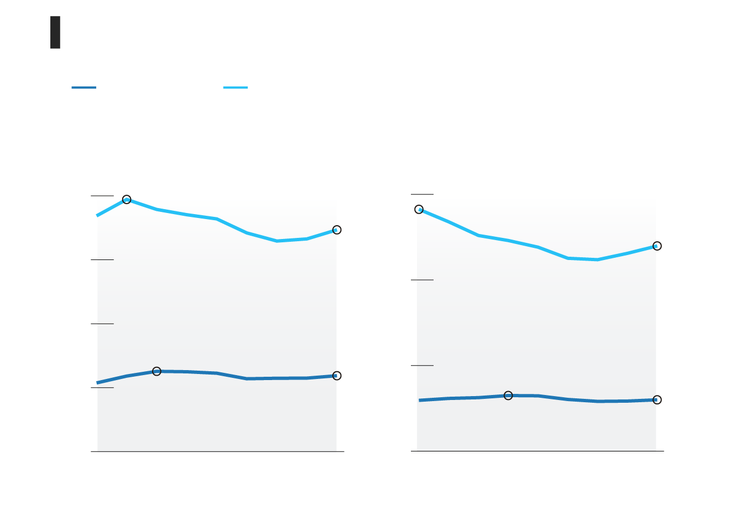
Budget cuts in Spain, 2007-2015 Employment (private and public) before (2007) and after (2015) the crisis, in Spain. Salaries (left) and jobs (right)
SOURCE: http://www.elmundo.es/economia/2016/04/25/571cf47f468aeb88178b4679.html

Slide 6
Budget cuts in Spain (2): Public jobs before (2007) and after (2015) the crisis
Central Government
Regional Governments
Municipal Governments
Total
SOURCE: http://www.elmundo.es/economia/2016/04/25/571cf47f468aeb88178b4679.html

Slide 7
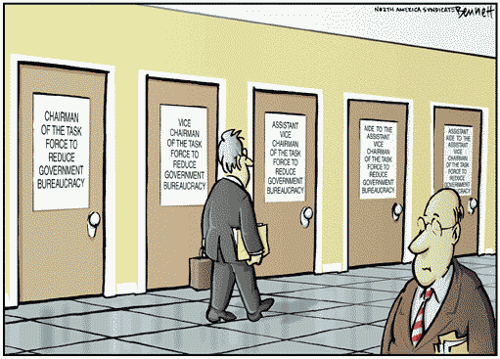

Slide 8
Summing up on budget battles, cuts & freezes
Budget office does not know where to cut
Units “game” the budget office
e.g., facing a budget cut, they cut service to most politically sensitive clients
Root causes subsist → recidivism
Even “zero-base” budgeting not much better than “incremental” budgeting
May even be an opportunity for strategic gaming

Slide 9
Radical solution: objective evaluation & incentives, aiming for an “internal market”
Users
prices (partial, total) and/or
opportunity cost through freedom of choice (among expenses, internal providers, external providers)
Providers
pay for performance, even profit sharing; and
freedom to organize provision
Budget office: upgraded to market designer and manager, big expense center itself
Objective: better resource allocation
Users reveal their information on value
Providers organize + efficiently (reveal info on cost)
→ Users’ demand guides providers’ supply

Slide 10
How real & artificial markets work
Real markets rely on property rights, which automatically
Evaluate performance
Reward owners
Reallocate resources
In artificial markets, a bureaucracy must perform the same tasks →

Slide 11
→ The tasks of a market planner
Design the market
Allocate decision rights
Design and implement evaluation systems
Reward decision makers who are not owners (agency)
Avoid market failure
Externalities: More than in real markets?
“Locus of uncertainty” problem—how serious? →
Tolerate market decisions →
If we are reluctant to close down private firms, will we accept the market’s verdict on public services?
Imagine closing down local hospitals,… universities

Slide 12
Jensen & Meckling’s “locus of uncertainty” problem
Matching supply and demand to avoid parties’ freedom causing surplus capacity
Factors:
Expense composition affects consumption predictability
Computers help real time budgeting
Capacity to speedy re-contracting of recourses
Flexibility for internal reallocation of recourses

Slide 13
Tolerating market decisions
Are internal markets applicable to...
... public healthcare? NHS? Shadow invoicing?
(How are health services for civil servants organized?)
... primary and secondary education? School subsidies?
... the university system?
But is there any point in creating an “internal market” if it will only be “disobeyed”?
Example: What changes and decisions has the current system of chartered schools (conciertos) led to?
E.g., restricting the supply of chartered school when demand for it increases
Uniform salaries?, co-education?

Slide 14
Chartered schools (“concertadas”)
Basis for internal market in place: private and public schools, money following users
When demography down, demand switched towards chartered schools
Planners in 17 regions decided against demand:
Constraints on users’ choice
Constraints on chartered schools growth
Chartered schools’ dropped to public standards?

Slide 15
Modest “automatic management” applying some market elements. Examples:
How are the following organized in Spain?
... Notaries?
... Property and mercantile registers?
How were the following organized up to the 1980s...
... courts?
... Primary health centers?
What are the characteristics of these solutions?
Powerful incentives?
Civil servants or employees?
Degree of regulation?
Effectiveness > efficiency?
What about transplants of human organs?
See, e.g., “Manufacturing Success” by Costas & Lozano

